Slide 1

Sentiment Analysis
using Machine Learning
Project Guide Project By
M.V Sumanth M Ravindrareddy
19X45F0002
Notes:
To use this title animation slide with a new image simply 1) move the top semi-transparent shape to the side, 2) delete placeholder image, 3) click on the picture icon to add a new picture, 4) Move semi-transparent shape back to original position, 5) Update text on slide.

Slide 2
Abstract
Sentiment analysis is the process of analyzing the emotion of the users.
You can categorize their emotions as positive, negative or neutral.
The reason behind this is every company is trying to understand the sentiment of their customers, if customers are happy, they will stay.
This project could show a path to reduce customer churn.

Slide 3
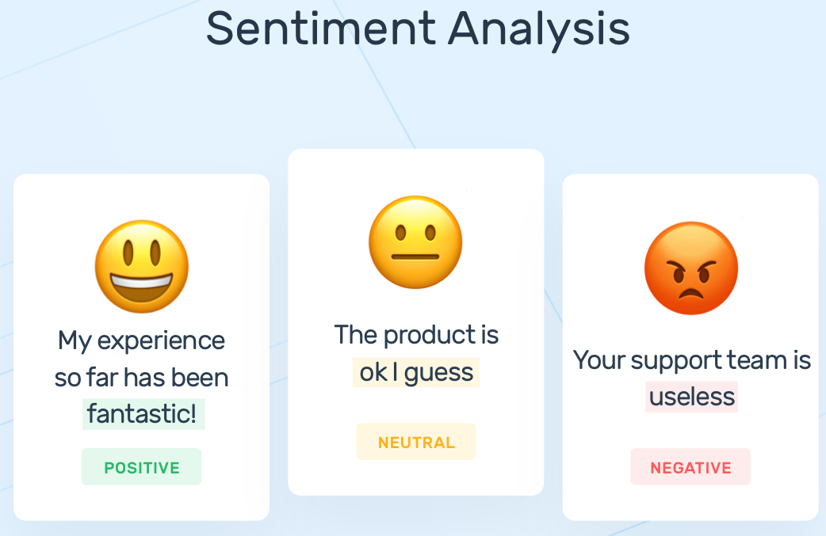
Objecctive
Sentiment analysis is a natural language processing technique used to determine whether data is positive, negative or neutral.
Sentiment analysis is often performed on textual data to help businesses monitor brand and product sentiment in customer feedback, and understand customer needs.
Sentiment Analysis mainly focus on:
the main objective of the project is whateve, sentiment analysis is focusses on the customer reviews and feedback.
.

Slide 4
Literature Survey
The following are the some Research papers:
A survey of sentiment analysis and deep learning
Author: Singhal (2016)
Methods: CNN, RNTN, RNN, LSTM
Dataset: Movie Reviews, Customer Reviews
Target: Comparison of classification performance of different models on different datasets
Sentiment analysis using AdaBoost combination
Author: Gao (2016)
Methods: CNN
Dataset: Movie reviews and IMDB
Target: Studying the possibility of leveraging the contribution of different filter lengths and grasping their potential in the final polarity of the sentence
Overview of deep learning for sentiment analysis
Author: Rojas-Barahona (2016)
Methods: CNN, LSTM
Dataset: Movie reviews, Sentiment Treebank, and Twitter
Target: To extract the polarity from the data

Slide 5
Literature Survey
The following are the some Research papers:
Sentiment analysis of short texts
Author: Hassan(2017)
Methods: CNN, LSTM, on top of pretrained word vectors
Dataset: Standford large Movie Review, IMDB, Stanford Sentiment Treebank, SSTb
Target: Achieving comparable performances with fewer parameters on sentiment analysis tasks.
How textual quality of online reviews affect classification performance
Author: Li (2018)
Methods: SRN, LSTM, and CNN
Dataset: Movie reviews from imdb.com
Target: Impact of two influential textual features, namely the word count and review readability.
Sentiment analysis based on rhetorical structure theory
Author: Kraus (2019)
Methods: Tree-LSTM and Discourse-LSTM
Dataset: Movie Database (IMD), food reviews (Amazon)
Target: Aim to improve accuracy

Slide 6
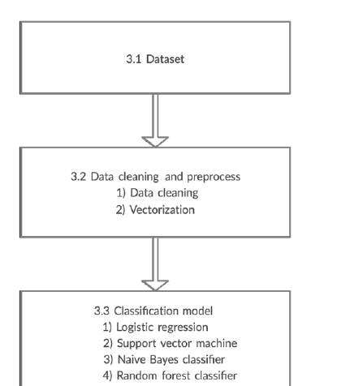

Methodology
First, the report illustrates and feeds the data into the data cleaning and preprocess.
the report removes the stop words and some irrelevant words from the original data.
the vectorization techniques are applied to transform text into a feature matrix.
the report applies three different algorithms to train and test the feature matrix.

Slide 7
Methodology
The following are the Methodology Reports:
Data cleaning and preprocess
Data cleaning
Vectorization
Binary vectorization
Word-count vectorization
n-grams vectorization
tf-idf vectorization
Classification model
Logistic regression
Support vector machine
Naïve Bayes classifier
DataSet
This dataset consists of 50,000movie reviews taken from IMDb.
Half of the data isused for training while the other half is used for testing. both the training and testing dataset have 50% of positive reviews and 50% of negative reviews.

Slide 8
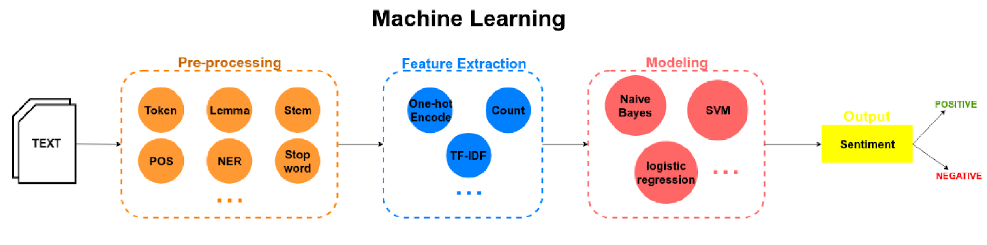

Block Diagram

Slide 9
Example DataSet
review | sentiment
One of the other reviewers has mentioned that after watching just 1 Oz episode you'll be hooked. They are right, as this is exactly what happened with me.<br /><br />The first thing that struck me about Oz was its brutality and unflinching scenes of violence, which set in right from the word GO. Trust me, this is not a show for the faint hearted or timid. This show pulls no punches with regards to drugs, sex or violence. Its is hardcore, in the classic use of the word. | Positive
This show was an amazing, fresh & innovative idea in the 70's when it first aired. The first 7 or 8 years were brilliant, but things dropped off after that. By 1990, the show was not really funny anymore, and it's continued its decline further to the complete waste of time it is today.<br /><br />It's truly disgraceful how far this show has fallen. The writing is painfully bad, the performances are almost as bad - if not for the mildly entertaining respite of the guest-hosts, this show probably wouldn't still be on the air. | Negative

Slide 10
Talking Points
Tools & Technologies
DataSet
Methods
Packages
IMDB dataset from Kaggle.com
Python 3,
Anaconda
Logistic Regression,
Support Vector Machine,
Naive Bayes Classifier
Numpy,
pandas
seaborn,
matplot
Reference : The basics you can find anywhere 5 Steps To Successful Storytelling Published on April 5, 2014 Featured in: Marketing & Advertising

Slide 11
How we are going to Analyse Text data.?

Slide 12
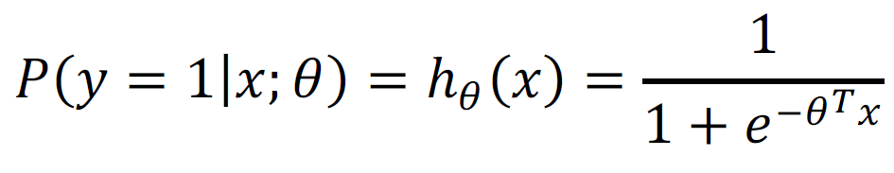

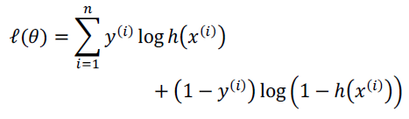
Logistic Regression
Logistic regression performs the binary classification by using a sigmoid function as the hypothesis.
the logistic model is used to model the probability of a certain class or event existing such as pass/fail, win/lose, alive/dead or healthy/sick.
This can be extended to model several classes of events.
The logistic regression model is trained by fitting the parameter 𝜃 via maximum likelihood, where the log likelihood function.

Slide 13
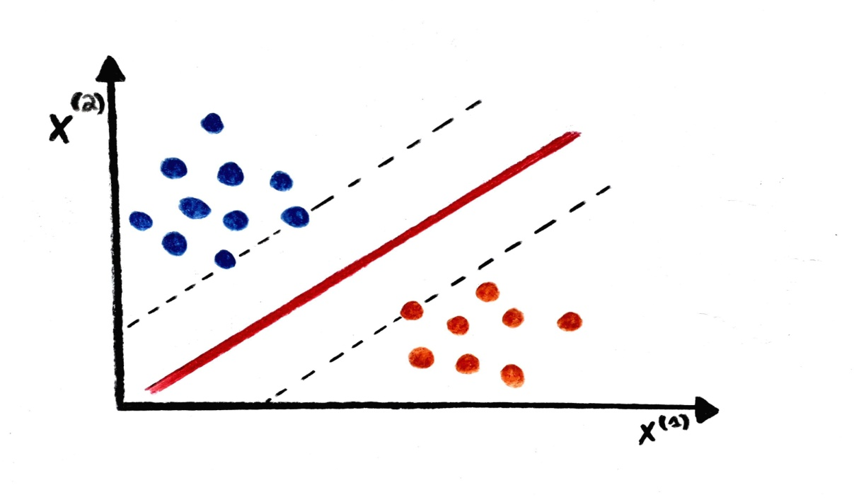
Support Vector Machine
support-vector machines are supervised learning models with associated learning algorithms that analyze data for classification and regression analysis.
SVMs are used in text categorization, image classification, handwriting recognition and in the sciences.
The hyperplane that separates the data with maximum margin is called the support vector classifier.
Which can be determined using Kernel Functions in order to avoid expensive computation to transform the data
explicitly

Slide 14
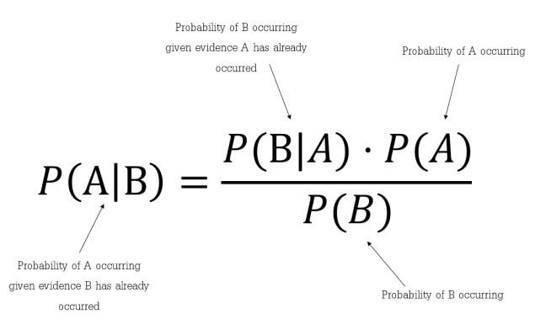
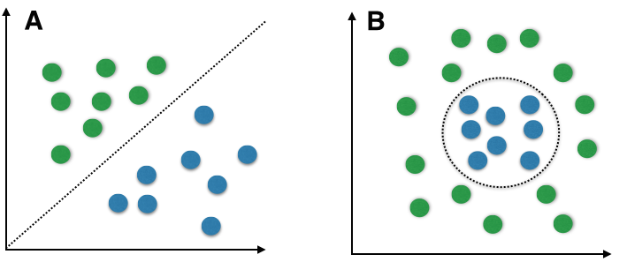
Naïve Bayes Classifier
naive Bayes classifiers are a family of simple "probabilistic classifiers" based on applying Bayes' theorem with strong independence assumptions between the features.
They are among the simplest Bayesian network models, but coupled with kernel density estimation, they can achieve higher accuracy levels.

Slide 15

It proposes a methodology to conduct the sentiment analysis of IMDb reviews.
the binary and n grams vectorization performs best among all three vectorizations for all the algorithms.
In term of negative accuracy, Naïve Bayes classifier, logistic regression, and SVM provide prediction accuracy, which is very promising for the sentiment analysis

Slide 16
Thank You
Neal Creative | click & Learn more

